Slide 1
POTHOLE DETECTION
Pothole detection using yolo algorithm.
Part of project blindly

Slide 2
Pothole using yolo
Accidents and loss of human lives are caused by potholes generated by severe rainfall and heavy vehicle activity
the suggested system employs the YOLO (You Only Look Once) v4 Algorithm to detect potholes.

Slide 3
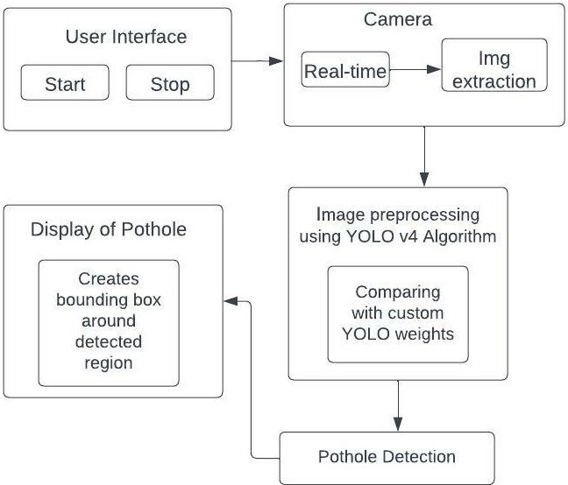
Methodology

Slide 4
When one selects the “Start” Option, the Camera switches on and live detection of potholes takes place. Now the camera keeps on recording while the YOLO v4 algorithm works in the back-end simultaneously. The required information necessary for detecting the potholes is captured.
The images are extracted throughout the live recording and accordingly a detection process is carried out. The YOLO v4 algorithm takes these images one by one and processes it.
It compares the information recorded from the images with the yolo weights. When a pothole is detected, it predicts a bounding box around it. The bounding box consists of a Box Label and Predicted Accuracy Percentage where Accuracy Percentage refers to the percent of how accurately a pothole is detected.

Slide 5
Implementation
On a single CPU, YOLOv4 optimizes real-time object detection and training. On the COCO dataset, YOLOv4 achieved stateof-the-art performance with 43.5 percent speed (AP) at 65 frames per second (FPS) on a Tesla V100.

Slide 6
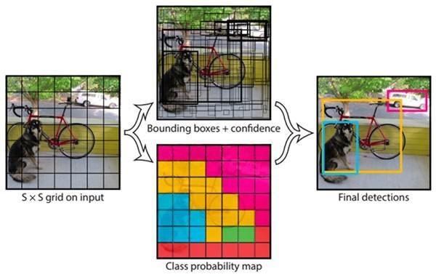
Deep learning approach
YOLO divides the input image into a S x S grid, with each grid cell anticipating the object that is centered in that grid cell.

Slide 7
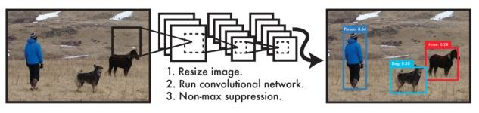
Bounding boxes and confidence scores for those boxes are predicted in each grid cell. These confidence scores represent the model's belief that the box contains an object as well as the accuracy with which it believes the box it forecasts is.

Slide 8
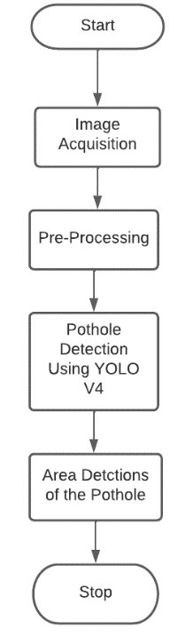
System flow
When the system starts, the camera is switched on and real time detection of potholes using Yolo V4 algorithm takes place. The images are extracted from live video and processed in order to detect potholes. The detected potholes are displayed in bounding boxes and as a result real-time potholes detection is achieved.

Slide 9
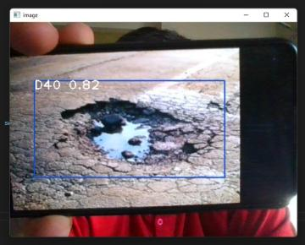
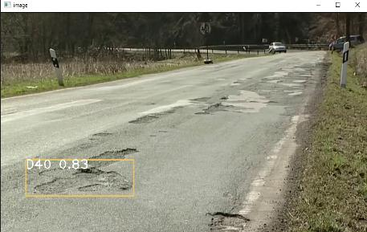
Results

